Slide 1
Chapter 2

Slide 2
Machine Cycle
The steps performed by the computer processor for each machine language instruction received.
The machine cycle is a 4 process cycle that includes reading and interpreting the machine language, executing the code and then storing that code.

Slide 3
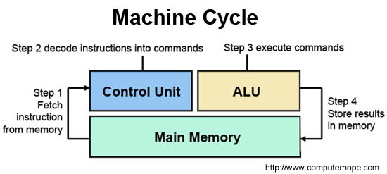

Slide 4
Control Unit
The control unit (CU) is a component of a computer's central processing unit (CPU) that directs the operation of the processor. It tells the computer's memory, arithmetic/logic unit and input and output devices on how to respond to a program's instructions.
It controls (conducts) data flow inside the processor and additionally provides several external control signals to the rest of the computer to further direct data and instructions to/from processor external destination's (i.e. memory).

Slide 5
Machine Cycle
Four steps of Machine cycle
Fetch - Retrieve an instruction from the memory.
Decode - Translate the retrieved instruction into a series of computer commands.
Execute - Execute the computer commands.
Store - Send and write the results back in memory.

